Slide 1
Online Insurance System

Slide 2
Agenda
Team
Project
Agile
Conclusion

Slide 3
Team
Online Insurance System
Team Members :-
Pintu Jat– Team Leader
Amruta Patil
Priyanka Londhe
Ankita Gholap
Utsav Acharya

Slide 4
Project
Introduction To Online Insurance System
Online Insurance System is a system where customer can buy a policy via agent .
Admin approves the registered agent and customer.
Agent can apply, make payment , and claim policies on behalf of customer.
Admin can add, delete, view policies and also the agent and customers in the system.
User can view , make payment and claim the policies and update the personal details.

Slide 5
What Did We Do ?
Underwent Training
Topics
Case Studies
Scratch Development
About Project
Project Stakeholders
Requirements Analysis
User Stories
UCD

Slide 6
Underwent Training
Topics -
JSP
Servlet with MVC architecture
Oracle Database
Case Studies -
Add / edit / view / delete Agent
Add / edit / view / delete Customer
Add / view / delete Agent
Buy Policy
Payment

Slide 7
Requirement Analysis
Functional Requirements –
Project Stakeholders
Admin
Customer
Agent
Admin Module
Login
Search Insurance
Buy Policy
Add Agent
Add Customer

Slide 8
Functional Requirements –
Agent Module
Registration
Login
Buy Policy – Agent can view , make payment and claim the policies on behalf of customer and update the personal details.
Customer Module
Registration
Login
Buy Policy – Customer can view , make payment and claim the policies and update the personal details.

Slide 9
Non-Functional Requirements –
Browser compatibility –
The application will be best viewed in Google Chrome browser
Session Management & Security -
The actors should have session management with respect to the user role. At no time, one user should be able to view the other user’s session related data, features & access privileges.
Usability -
Following requirements concerning the ease with which the system can be used.
Consistent Web based UI
Easy to use and navigate
Provide easy access by implementing Ajax and avoid page refresh wherever possible

Slide 10
User Stories –
They are simple plain –
English sentences that aim to capture the essence of a request in a tight focused format so that everyone
– technical and non-technical
– understands what is needed and why.
User stories provide a quick way to handle requirements without a big, annotated document that is difficult to read.
User should be able to add/delete/update topic.and he should also able to add comment and view comment on forum.

Slide 11
What Did We Do ?
Architecture and Design
Application Architecture
Data Models
Screen Shots
Implementation - Coding
Code Screen Shots

Slide 12
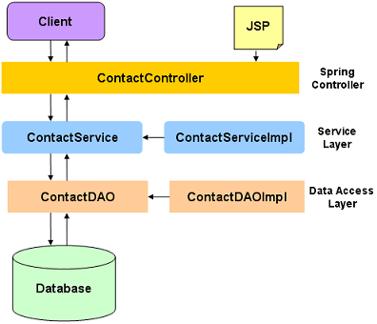
Architecture and Design
Application Architecture
JSP Page ->Controller -> Service -> Service Implementation- > DAO Implementation-> DAO -> DB
DB -> DAO -> DAO Implementation -> Service Implementation ->Service -> Controller -> Output
\

Slide 13
Project Team
Project Stake-Holders
Project Title | Online Retail
Name of Client | Manipal
Project Sponsor | Manipal
Project Owners | Manipal
Scrum Master | Janakiram
Architect | Kumaresh
QA Manager | Sunil
Infrastructure Mgt. | IT Team
Developers | Pintu Jat , Amruta Patil, Ankita Gholap ,Priyanka Londhe, Utsav Acharya.

Slide 14
Project Activities
Requirement Gathering and Analysis
Team of Dedicated BA’s and QA’s
Documenting Requirements (User Stories)

Slide 15
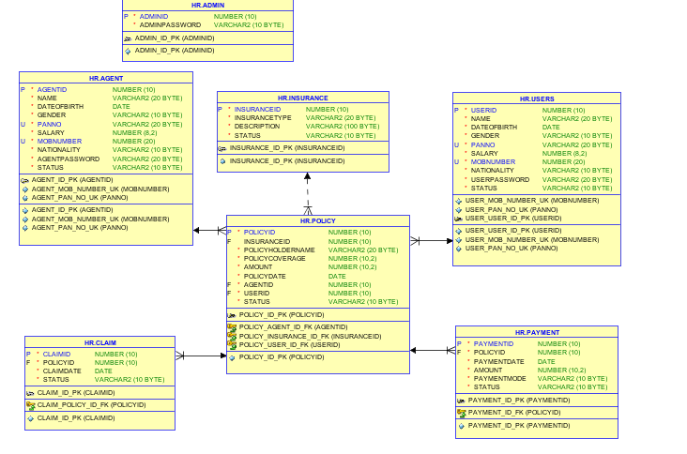
Class Diagram

Slide 16
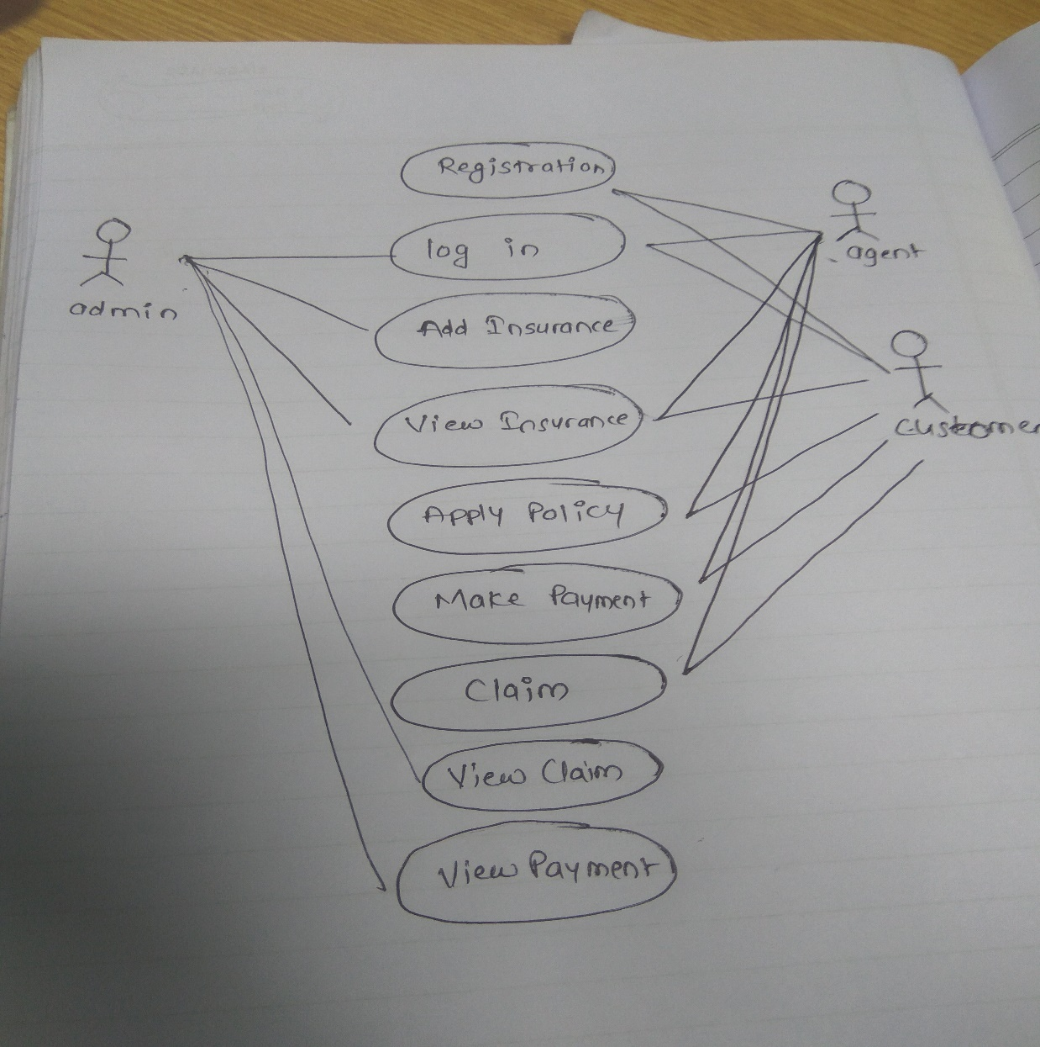
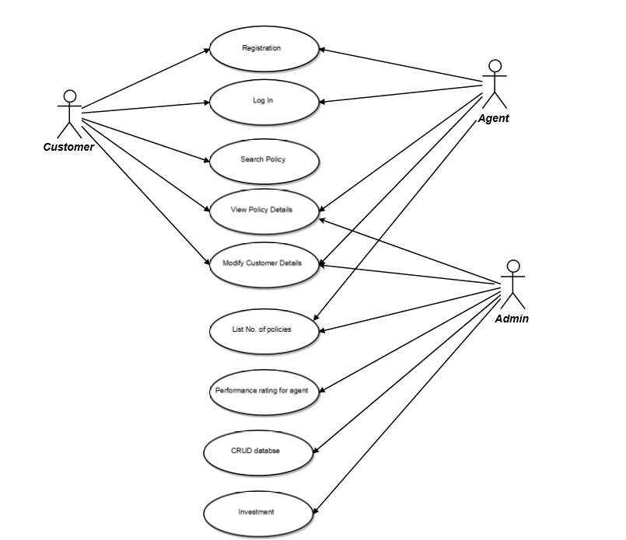
Use Case Diagram

Slide 17
The Tech Stack
Client Side | Server Side
HTML5, CSS3 | JEE
 | JDBC
 | Servlet, JSP

Slide 18
IDE and Other Tools
Tools | Software
Java IDE | Eclipse
Web Server | Apache Tomcat 7.0 Server
Database | Oracle 10G

Slide 19
Component Identification
Online Insurance System is a system where customer can buy a policy via agent . User can view , make payment and claim the policies and update the personal details.
In the Online Insurance System, Admin approves the registered agent and customer. Admin can add, delete, view policies and also the agent and customers in the system.
This portal would essentially have 2 modules:
User Module –User can view , make payment and claim the policies and update the personal details.
Agent Module – All admin related operations related to adding / maintaining a new Category, adding / maintaining a new topic, and also maintaining the discussion in forum will be part of this module.
LLD

Slide 20
The package statement must be the first statement of the file.
Practiced Standard Coding Guidelines and Standards
Names representing packages should be in all lower case
Variable names must be in mixed case starting with lower case.
Names representing constants (final variables) must be all uppercase using underscore to separate words.
Generic variables should have the same name as their type.
The terms get/set must be used where an attribute is accessed directly.
Imported classes should always be listed explicitly.

Slide 21
Artifacts
SRS Document
System Architecture
Application Architecture
User Stories
UI Screenshots
Database Design
Test Scenarios
Test Cases
Code
Unit Tests

Slide 22
Conclusion
Online Insurance System is a system where customers can easily apply for a policy directly or via agent from his/her present location .
Everything from searching for policy, type of insurance, cancelling the policy can be done through the system.

Slide 23
Thank You

